Slide 1
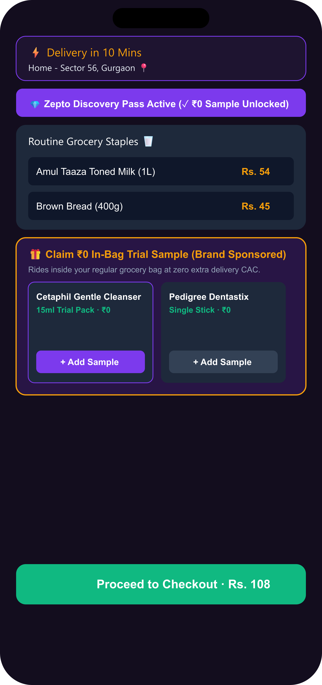
CATEGORY STREAK + GROCERY POINTS CROSS-SUBSIDY MODEL
1. Zepto Expands Blended Gross Margin (+300bps) by Converting Daily Grocery Habits into Recurring Multi-Category Buying
Funding grocery point rewards from high-margin non-grocery categories to bypass traditional P&L subsidy limits.
📋 STRATEGIC BRIEF & PM SCOPE
• Role & Scope: PM on Zepto Growth Team driving trust-led cross-category discovery.
• Routine Tunnel Vision: 71.2% of active users are locked into fast daily grocery staple checkouts (<45 seconds).
• Strategic Objective: Lift Monthly Active Customers (MAC) buying from 2+ categories from 8.2% to 28.4% in 12 months.
• Target Categories: Personal Care (35% margin), Pet Supplies (45% margin), Electronics (30% margin), Baby Care (35% margin).
⚡ THE CROSS-SUBSIDY ARBITRAGE MODEL
• Grocery Point Cross-Subsidy: Earning 2x points on morning staples (milk, eggs) offsets the customer's grocery bill.
• Sustainable Arbitrage: Points are funded from high non-grocery margins (~35–45%), not from direct P&L discounts.
• Ecosystem Lock-in: Competitors cannot copy this cross-subsidy without gross margin arbitrage (or subsidizing from P&L).
• Compounding Flywheel: More category exploration -> more grocery points -> stronger grocery habit retention.
🔗 PORTAL DIRECTORY & VERIFIED HYPERLINKS
Live Streamlit App: https://zeptomvp2.streamlit.app | Figma Design System: https://www.figma.com/design/2gZJHtjmpnI677IhC66PqZ/Untitled?node-id=0-1 [Open Live App] [Open Figma]
Context
Market
Research
Insights
Canvas
Ideation
MVP
Architecture
Metrics
GTM

Slide 2
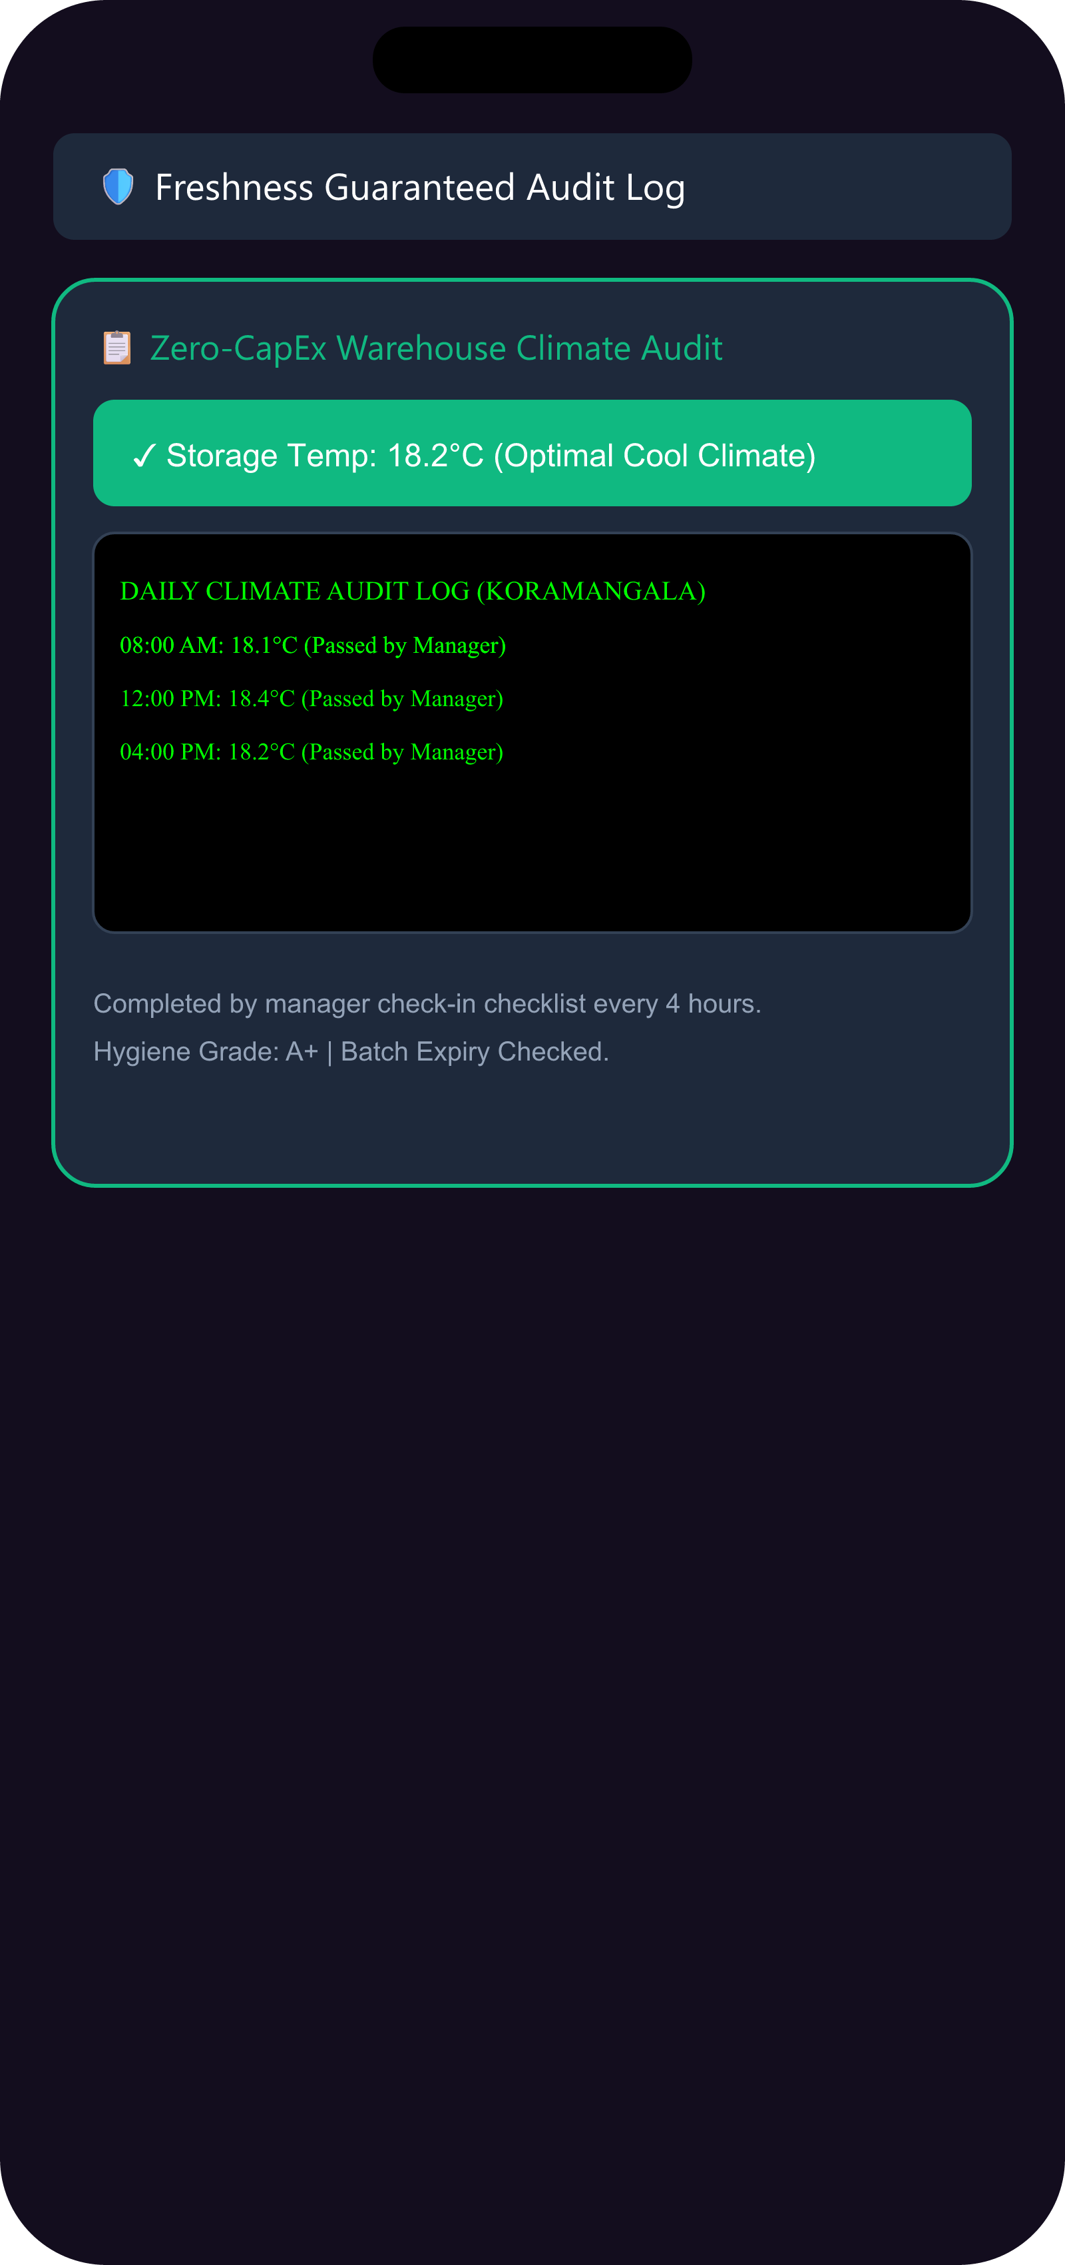
CONVENIENCE-JUSTIFIED TOP-UPS VS PLANNED BULK BUYS
2. Users Leak Planned Non-Grocery Spending to Amazon/DMart; MVP Targets Restock Cadence and Trial-to-Repeat Loops
Shifting focus from massive bulk orders to convenience-justified trials and replenishment intercepts.
⭐ WHAT THE ECOSYSTEM HAS SOLVED
• 10-Minute Hyperlocal Delivery Speed (Zepto, Blinkit, Instamart).
• Dark Store Density & Real-Time Stock (500+ Dark Stores).
• Sub-Second Cart Search & Auto-Complete UI.
❌ CADENCE & TRIAL-TO-REPEAT BLIND SPOTS (N=24 DATA)
• Purchasing Leakage: 83% (20/24) buy planned non-grocery items on Amazon/Nykaa/DMart [Survey Q3, N=24].
• Planned Mismatch: 33% (8/24) cite planned bulk-buy mismatch as the #1 barrier [Survey Q4].
• Zero Cadence Nudges: No Q-Commerce platform currently offers reorder suggestions based on user time gaps.
• Trust & Quality Friction: 20.1% fear quality degradation; 17% (4/24) fear refund chatbot loops.
★ CORE THESIS TESTED & VALIDATED
Exploration stalls because trial samples are treated as one-offs. Fix: Free sample -> Category Streak Quest -> grocery offset. Restock cadence nudge intercepts Amazon orders 2 days before purchase. [Open Live App] [Open Figma]
Context
Market
Research
Insights
Canvas
Ideation
MVP
Architecture
Metrics
GTM

Slide 3
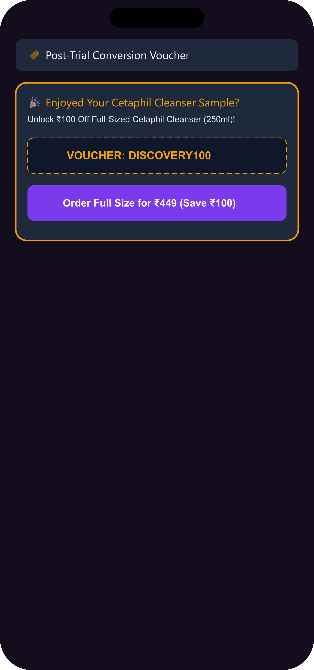
AI REVIEW WORKFLOW & PRIMARY RESEARCH SYNTHESIS
3. Multi-Platform Mixed Review Corpus (10k Items) & Survey Isolate 3 Core Pillars: Delights, Feature Requests & Barriers
Synthesizing 10,000 mixed reviews (40% Positive, 30% Neutral, 30% Negative) and primary N=24 survey into actionable insights.
📊 AI PIPELINE & SYNTHETIC CORPUS (10,000 ITEMS)
• Pipeline: Ingested 10,000 records across 10 channels -> 40% Positive Delights, 30% Neutral Requests, 30% Frictions.
• 40% Positive Delights (4,000 items): High adoption for sub-10 min emergency refills (sunscreen, travel grooming, pet treats).
• 30% Neutral Feature Requests (3,000 items): Unmet demand for Shade Matchers, Doorstep Try & Inspect, and Category Streaks.
🎯 3 SYNTHESIZED BARRIER BUCKETS (N=24 SURVEY)
• 1. Mismatch Barrier (33%, 8/24): Planned bulk buys elsewhere — intercept 2 days prior via cadence data.
• 2. Trial-to-Repeat Gap: Sampling exists but lacks an outcome loop to convert initial trial to repeat buying.
• 3. Cross-Subsidy Appeal (63%, 15/24): Prefer grocery points on streaks over flat cashbacks (38% trial via sample; 92% trust doorstep swap).
💡 RESEARCH CONCLUSION & INSIGHT SYNTHESIS
Users do not need generic ads. They need Category Streaks (lock-in loyalty), Cadence Nudges (intercept bulk buys), and Outcome Loop Cards (drive repeat). [Open Live App] [Open Figma]
Context
Market
Research
Insights
Canvas
Ideation
MVP
Architecture
Metrics
GTM

Slide 4
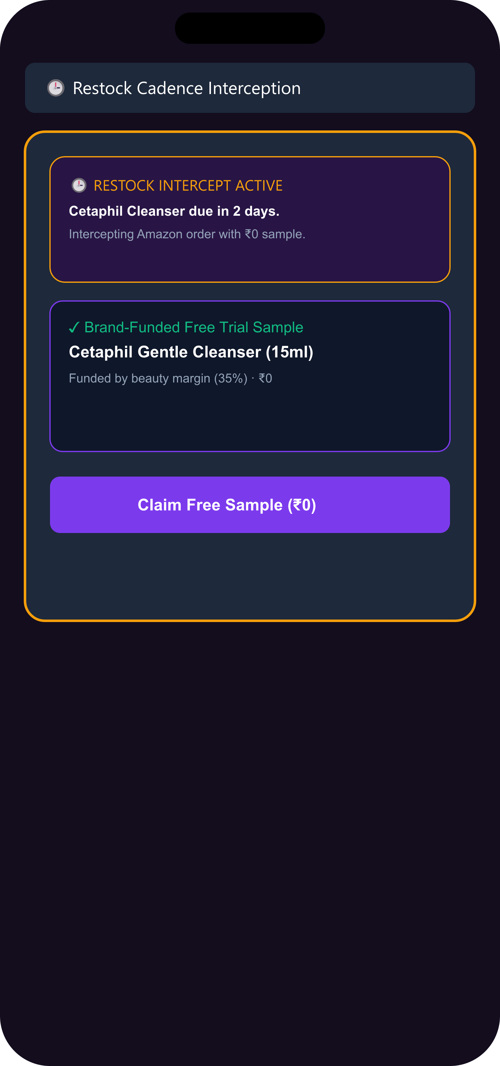
HIGH-FREQUENCY GROCERY BUYERS WHO LEAK NON-GROCERY SPEND
4. High-Frequency Grocery Refillers (79% Weekly+) Form the Prime Wedge to Intercept Planned Non-Grocery Restocks
Targeting retained grocery refuelers and using grocery cadence to intercept Amazon purchases 2 days before restock.
📊 TARGET COHORT PROFILE & RATIONALE
• Cohort Definition: Weekly+ grocery users (79%, 19/24) leaking non-grocery spend (83%, 20/24) [Survey N=24].
• Strategic Fit: Retained, high-frequency users yield lower CAC than acquiring new users.
• Predictive Interception: Grocery cadence predicts non-grocery restock timing -> nudge fires 2 days before Amazon order.
• Trust Transfer: Daily Zepto staple use lowers friction for adjacent category trials.
👤 PERSONA: NEHA — SKINCARE FAN, 26, BANGALORE
• JTBD: When ordering morning milk, I want to try skincare samples so discovery offsets my grocery bill.
• Quote: "If trying a new brand gets me 2x points on daily bread, it becomes a monthly habit."
• Pain: Cautious Explorer — wants to try beauty care but fears dark-store expiry and refund friction.
• Fit: Risk-free ₹0 sample + streak point converts existing demand with zero operational overhaul.
🎯 IMPACT IF SOLVED FOR THE CAUTIOUS EXPLORER
Cuts pre-checkout anxiety loops. Makes multi-category exploration safe. Boosts customer LTV up to 3.4x via B2B sampling and loyalty points lock-in. [Open Live App] [Open Figma]
Context
Market
Research
Insights
Canvas
Ideation
MVP
Architecture
Metrics
GTM

Slide 5
SUPPLY-SIDE MONETIZATION & UNIT ECONOMICS RIGOR
5. Brand-Funded Cross-Subsidy Yields Positive Unit Economics with Immediate Payback on Cross-Category LTV
Grocery rewards are funded by non-grocery margins (~35–45%), not from Zepto P&L.
📈 TAM / SAM / SOM OPPORTUNITY SIZING
• TAM: $18.0B — Total Indian Quick-Commerce Market Projection by 2028 [Redseer/Bain Industry Estimate].
• SAM: $4.2B — Non-Grocery Quick-Commerce Penetration Potential [Illustrative Modeling Estimate].
• SOM: $480M — Zepto Cross-Category Discovery Capture Opportunity [Illustrative Modeling Estimate].
💰 UNIT ECONOMICS & CROSS-SUBSIDY MATH
• B2B Brand Sample Fee: Brand pays ₹15/unit -> Zepto earns ₹15 at zero extra delivery cost.
• Streak Reward: 2x points on ~₹50 grocery order ≈ ₹5 reward; funded from non-grocery margin.
• Cross-Subsidy Math: ₹499 BPC order @ 35% margin = ₹175 gross profit; easily covers ₹5 streak reward x 35 orders.
• Net Impact: Cross-category trial is margin-accretive at scale (+300bps gross margin lift) — not a discount or subsidy.
💡 FINANCIAL FLYWHEEL SUMMARY
Shifting grocery refillers to 35%–50% margin categories expands blended gross margin by +300bps and captures $480M SOM. [Open Live App] [Open Figma]
Context
Market
Research
Insights
Canvas
Ideation
MVP
Architecture
Metrics
GTM

Slide 6
COMPOUNDING DATA FLYWHEEL VS COPIABLE PROMOS
6. Zepto's Defensibility Lies in its Restock Cadence Engine and Local Purchase-Graph, Not Copiable Promos
Flat discounts are easily copied; restock history and PIN-code purchase graphs create years of defensibility.
⚡ TRIVIALLY COPIABLE VS COMPOUNDING MOATS
• Copiable Promos: Free samples/coupons and 15-min swap policies can be copied by Blinkit/Instamart in a sprint.
• Moat 1 — Cadence Engine: 6–12 months of per-user order history required. Rivals starting today face a 1-year data gap.
• Moat 2 — PIN-Code Social Graph: Years of dark-store density. Amazon/DMart structurally cannot replicate.
• Moat 3 — Outcome Attribution: Trial-to-repeat data -> Zepto Atom. No banner ad can match this performance.
🏆 THREE STRATEGIC HORIZONS (RICE MATRIX)
• Horizon 1 (MVP) — Streak + Cadence + Outcome: Zero CapEx (brands fund samples). RICE: 230 [Vetted MVP].
• Horizon 2 (Growth) — Lifecycle + Neighbourhood Feed: Self-declared life moments + opt-in trend feed (50+ user min). RICE: 190.
• Horizon 3 (Vision) — Predictive Auto-Replenishment: Set-and-forget cross-category companion. RICE: 150.
💡 WHY HORIZON 1 WINS FIRST
Horizon 1 wins first: zero CapEx, attacks the #1 barrier directly, and embeds in recurring grocery bags. H2/H3 require the data H1 generates. [Open Live App] [Open Figma]
Context
Market
Research
Insights
Canvas
Ideation
MVP
Architecture
Metrics
GTM

Slide 7
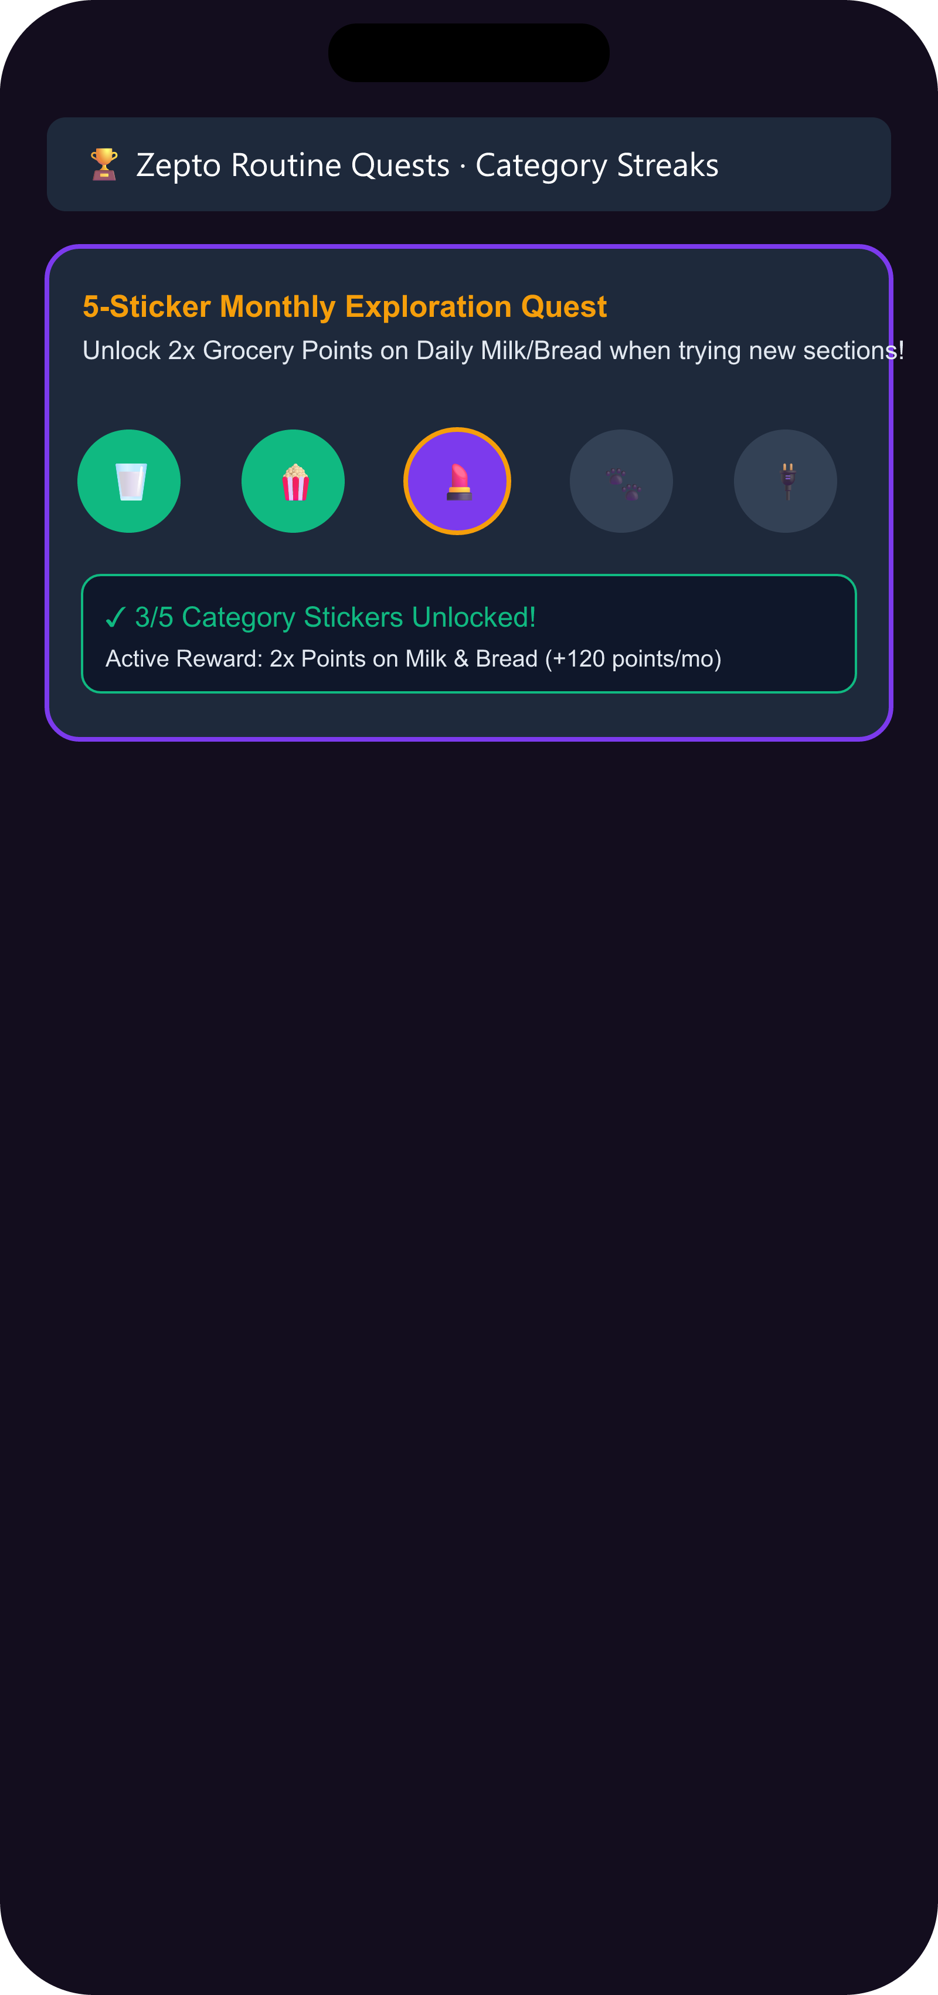
THE FLYWHEEL MVP: STREAKS, CADENCE NUDGES, OUTCOME CARDS
7. The Discovery MVP Embeds Category Streaks, Cadence Nudges, and Post-Trial Outcome Loop Cards
Connecting trials, streaks, and intercepts into a closed-loop category adoption system.
💎 3 CORE BUILT MVP CAPABILITIES
• 1. 🏆 Category Streak Board: Pre-stamped Pantry sticker (Endowed Progress Effect: 34% vs 19% completion rate) -> 2x grocery points.
• 2. 🕒 Cadence Interception Nudge: Restock timing engine fires 2 days before Amazon bulk buy (offers ₹0 brand-funded trial pack).
• 3. 📦 Outcome Loop Card: Trial-to-repeat converter fires at 48h with PIN-code proof ('847 near you reordered'). Rate & Add to next cart.
🏆 HORIZON 2 EXPANSIONS & TRUST SIGNALS
• 4. 🔄 Lifecycle Moment Interceptor: Basket signal prompts self-declaration card (baby diaper addition).
• 5. 🔥 Neighbourhood Trend Feed: Opt-in, 50+ user min, sensitive-category blocklist, PIN-code dark-store data moat.
• 6. 🛡️ Freshness Guaranteed Badge: Checkout trust signal — zero IoT hardware infrastructure required at MVP stage.
🎨 LIVE FIGMA DESIGN SYSTEM & INTERACTIVE MVP PORTAL
Live MVP Portal: https://zeptomvp2.streamlit.app | Figma Design System: https://www.figma.com/design/2gZJHtjmpnI677IhC66PqZ/Untitled?node-id=0-1 [Open Live App] [Open Figma]
Context
Market
Research
Insights
Canvas
Ideation
MVP
Architecture
Metrics
GTM

Slide 8
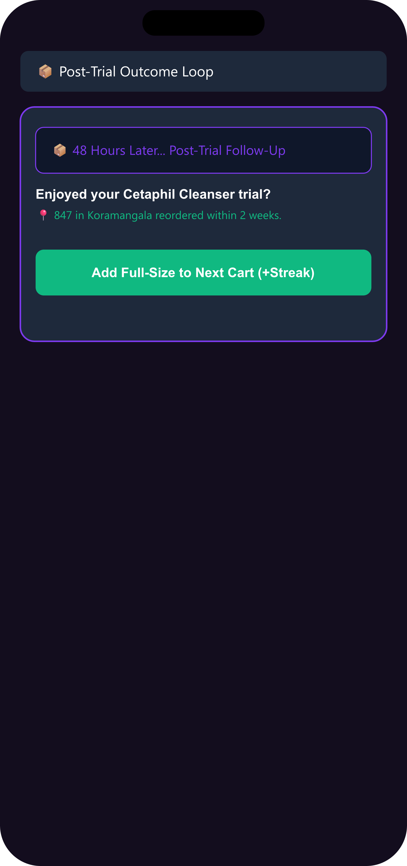
FROM A TYPED GROCERY CART TO A TRUSTED CROSS-CATEGORY ORDER. SAME APP, TWO VIEWS.
8. Four-Layer Decision Engine Powers Predictive Restock Nudges and Closed-Loop Brand Attribution
Four-layer architecture integrates brand inventory, cart triggers, and loyalty ledgers.
⚙ SYSTEM ARCHITECTURE (4 CORE LAYERS)
• Layer 1 (Client UI): Mobile Cart UI + pre-stamped Streak Board + Cadence widget + Outcome Card + B2B Sampler Carousel.
• Layer 2 (Decision Engine): Restock Cadence Engine (6–12mo history) + Endowed Progress Tracker + Social Graph Parser.
• Layer 3 (Operations): Dark-store picker checklist (sample insertion <3s SLA) + Freshness Guaranteed badge.
• Layer 4 (B2B Marketplace): Brand attribution dashboard (sample-to-repeat conversion rates per cohort via Zepto Atom).
🔄 USER EMOTION & METRIC MAPPING ACROSS 4 STAGES
• Stage 1 (Cart - Curious): Types grocery staples -> streak board + cadence signal flagged.
• Stage 2 (Nudge - Confident): Claims ₹0 sample -> packed in bag in <3s with zero checkout friction.
• Stage 3 (Follow-Up - Reassured): Outcome Loop Card at 48h -> sees '847 near you reordered' + streak CTA.
• Stage 4 (Repeat - Empowered): Rates + adds full-size -> streak advances -> 2x grocery points earned.
💡 TECHNICAL ARCHITECTURE MOAT & FEASIBILITY
Zero hardware cost for MVP sampler. H2 optional S3 photo storage capped at <$15/month via 7-day TTL lifecycle rules. [Open Live App] [Open Figma]
Context
Market
Research
Insights
Canvas
Ideation
MVP
Architecture
Metrics
GTM

Slide 9
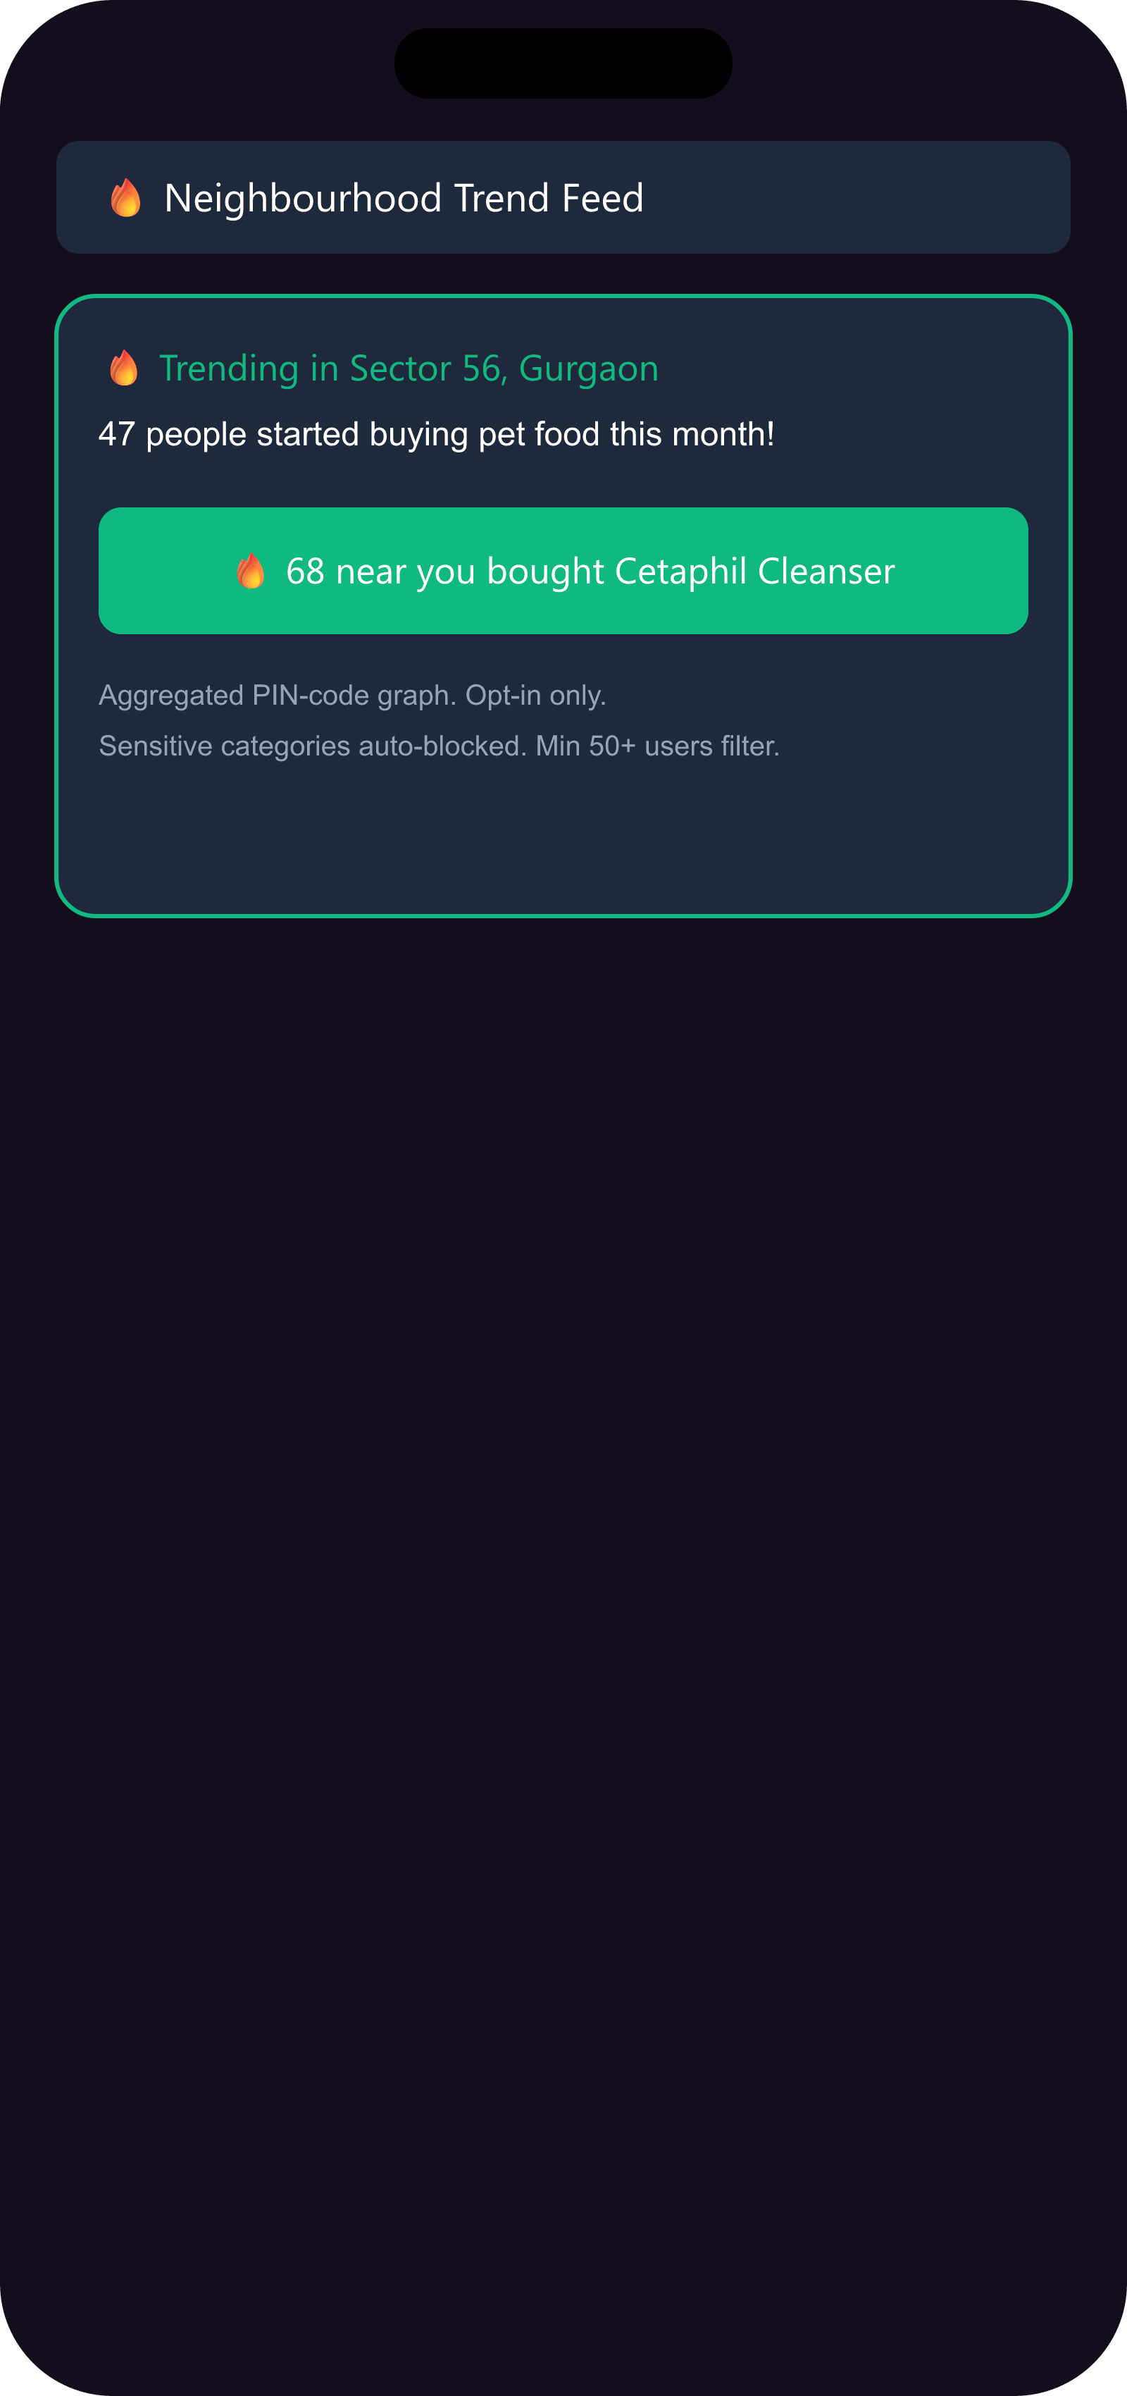
INCREMENTAL LIFT VIA RANDOMIZED HOLDOUT GROUPS
9. MCER Growth (8.2% -> 28.4%) Is Validated via Randomized Holdout Groups and SLA Guardrails
Measuring true incremental lift via control groups rather than raw attach proxies.
⭐ NORTH STAR & INCREMENTALITY DESIGN
• North Star Metric: Monthly Category Exploration Rate (MCER) — % of MACs purchasing from 2+ categories/month.
• Trajectory Target: Baseline: 8.2% -> M3 (Pilot): 14.5% -> M6 (Metro): 21.0% -> M12 Target: 28.4% [Illustrative].
• Holdout Control: 10% randomized control group (no sample/streak/nudge); MCER lift = treatment delta vs control.
• Leading Indicators: Sample attach rate (>35%), trial-to-repeat rate (≥12%, 14 days), streak completion rate (≥40%).
🛡️ OPERATIONAL GUARDRAILS & KILL THRESHOLDS
• Picker SLA Floor: Packing time addition capped at <3 seconds per order. Checkout drop-off cap <0.2%.
• Refund Rate Ceiling: Doorstep replacements below 1.5% of non-grocery orders. Privacy Floor: 50+ users/PIN min.
• Kill Threshold 1: Sample attach < 15% after 30 days -> stop sampling, pivot to nudge-only.
• Kill Threshold 2: Trial-to-repeat < 8% in 14 days -> retrain model. MCER lift < 2pp at 90 days -> pause and redesign.
📈 METRIC COMPOUNDING & INTEGRITY
MCER is measured strictly from real event streams: sample claims, streak completions, voucher redemptions. Zero proxies. Holdout ensures causality. [Open Live App] [Open Figma]
Context
Market
Research
Insights
Canvas
Ideation
MVP
Architecture
Metrics
GTM

Slide 10
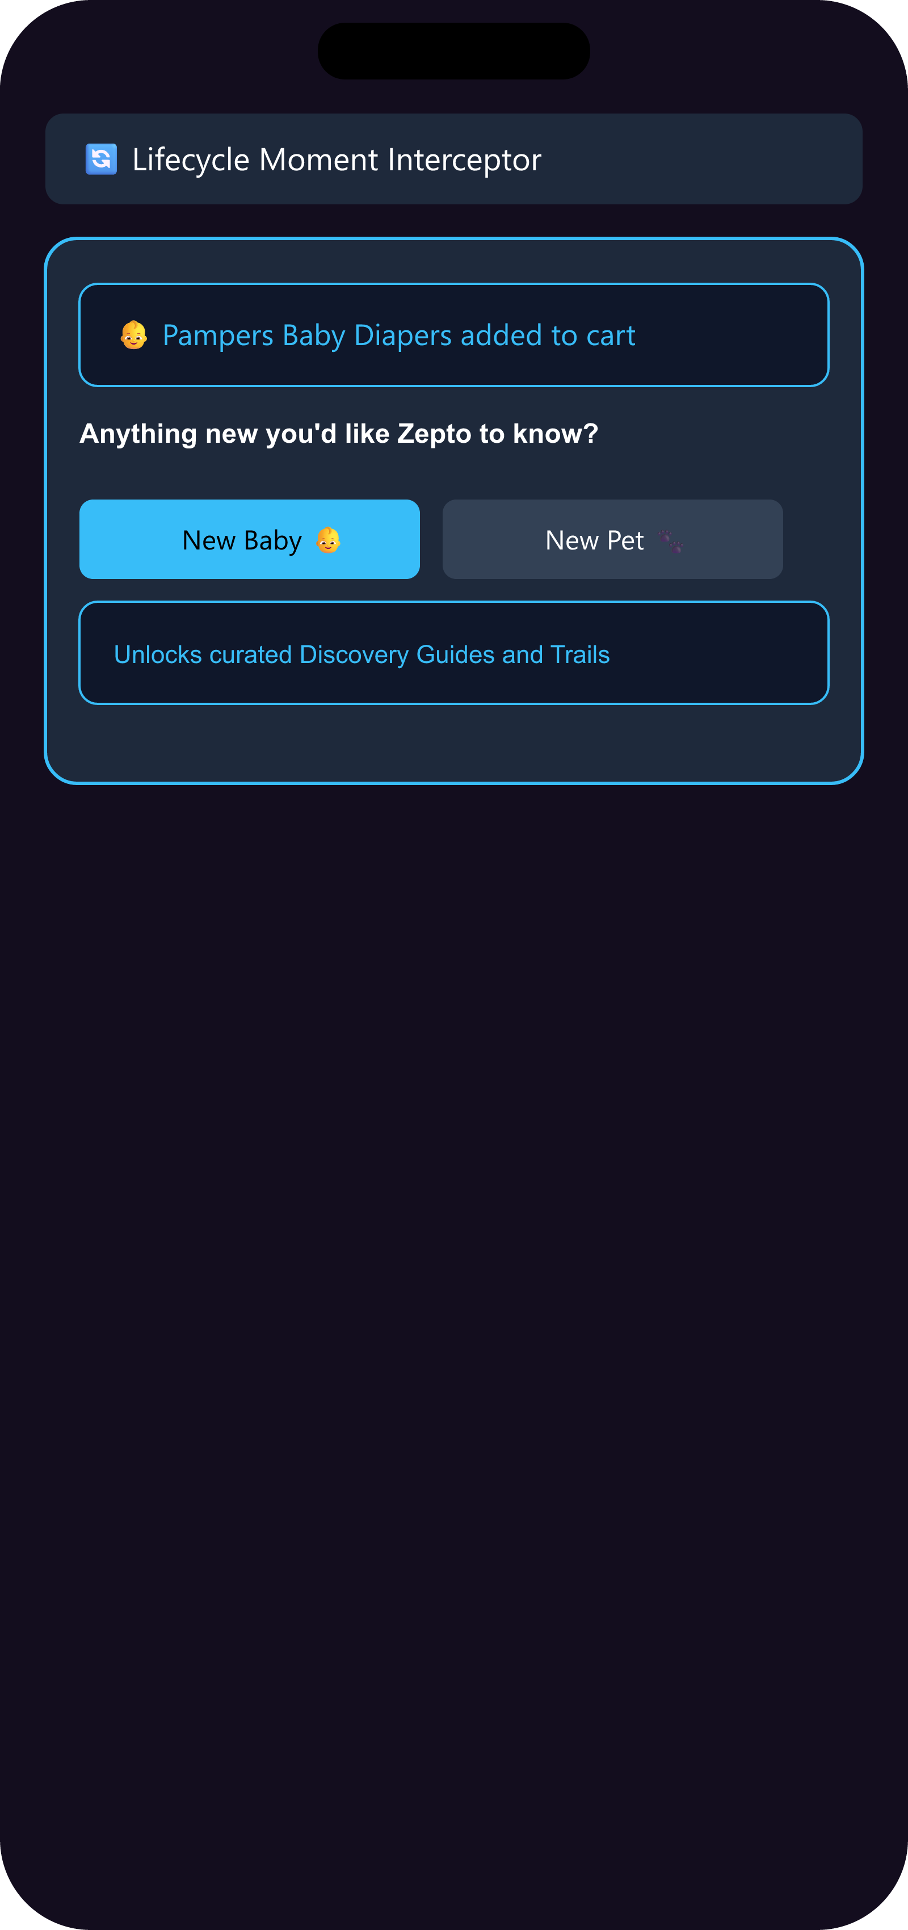
HORIZON 2 ROADMAP & PRIVACY GUARDRAILS
10. Phased GTM Roadmap Launches Horizon 1 MVP While Building Horizon 2 Privacy-Guardrailed Features
Phased rollout for Category Streaks, Cadence Intercepts, Lifecycle Moments, and Trend Feeds.
🚀 4-PHASE GTM ROLLOUT STRATEGY
• Phase 1 (30 Days - MVP Beta Bangalore): Streak + Cadence Nudge + Outcome Cards across 10 dark stores with Cetaphil & Pedigree.
• Phase 2 (90 Days - Metro Rollout): Expand H1 to all Tier-1 metros (150 dark stores); launch B2B brand portal (Gate: MCER lift ≥3pp).
• Phase 3 (180 Days - Horizon 2 Beta): Lifecycle Interceptor (self-declared) + Neighbourhood Feed (50+ user min, opt-in).
• Phase 4 (GA - National Scale): Full rollout across 500+ dark-store hubs. H3 auto-replenishment roadmap.
⚠️ RISKS, MITIGATIONS & DIRECTORY
• Rival Copying -> Streak + grocery cross-subsidy requires rivals to have identical non-grocery margin structure.
• Data Runway -> Start cadence data collection Day 1 of pilot; 6–12 months needed for accurate interception.
• Privacy Backlash -> Opt-in only, 50+ user PIN-code min, sensitive-category blocklist, DPDP-compliant consent.
• Live MVP Portal: https://zeptomvp2.streamlit.app | Figma Design System: https://www.figma.com/design/2gZJHtjmpnI677IhC66PqZ/Untitled?node-id=0-1
🔒 PRIVACY PRINCIPLE & DIRECTORY
Privacy principle: Zepto knows what you buy. It should never make you feel watched. Live Demo: https://zeptomvp2.streamlit.app | Figma: https://www.figma.com/design/2gZJHtjmpnI677IhC66PqZ/Untitled?node-id=0-1 [Open Live App] [Open Figma]
Context
Market
Research
Insights
Canvas
Ideation
MVP
Architecture
Metrics
GTM

